Slide 1
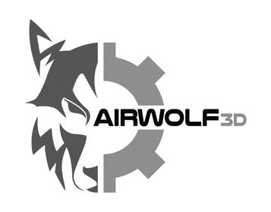
Airwolf 3D
Innovative Leader in 3D Design and Printing Solutions
BY
BENOLIN JOHN J S
61772251015
III-yr MECH.

Slide 2
Introduction
This presentation provides an overview of Airwolf 3D, focusing on its history, 3D design methodologies, product output, and more.

Slide 3
Company Overview
01

Slide 4

Year Established
Airwolf 3D was established in 2013, entering the market with innovative 3D printing technology aimed at both professionals and educators.

Slide 5
Origin
The company originated in the United States, founded by artist and engineer Aleph Objects, focusing on developing high-quality 3D printers.

Slide 6
Business Worth
As of 2023, Airwolf 3D is valued at approximately $5 million, attributed to its unique designs and strong customer base in various sectors.

Slide 7
02
3D Design Focus

Slide 8
Types of 3D Design
Airwolf 3D specializes in various types of 3D design, including educational models, prototypes, and artistic creations tailored for multiple industries.

Slide 9
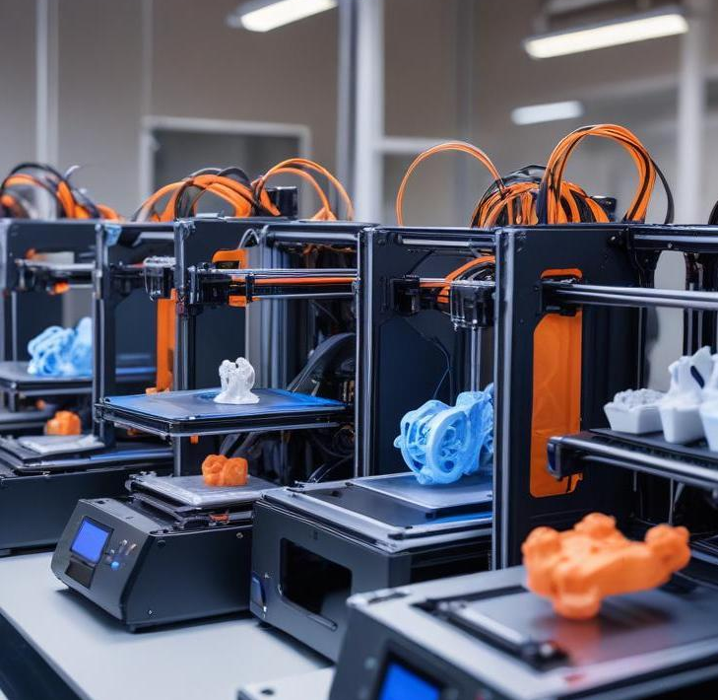
Machine Types Used
The company utilizes a range of 3D printers, from FDM models for general purposes to specific printers designed for high-detail crafting.

Slide 10
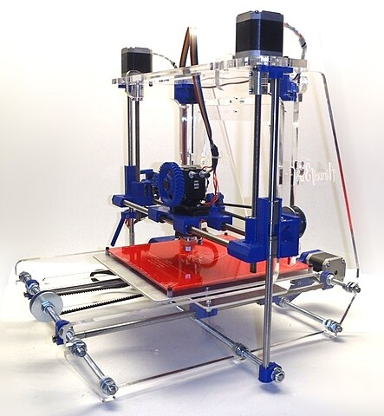
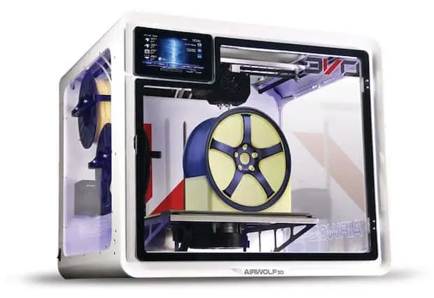

Slide 11
Branches of Application
Their 3D printing solutions cater to multiple branches, including education, manufacturing, healthcare, and artistic fields, addressing diverse needs.

Slide 12
Product Output
03

Slide 13
Types of Products
Airwolf 3D offers a variety of products including desktop 3D printers, specialized models for educational purposes, and high-resolution printers for intricate designs. Their products cater to both beginners and professional users, allowing for a diverse range of applications from hobbyist projects to industrial manufacturing.

Slide 14
Key Features
The 3D printers by Airwolf are recognized for their reliability, user-friendly interface, and versatility. Features include high print speeds, compatibility with multiple filament types, and advanced software integration for design efficiency. They emphasize durable construction and ease of maintenance, making them ideal for frequent use.

Slide 15

Market Reach
Airwolf 3D has established a strong presence in various markets, primarily in the United States but expanding globally. They serve sectors such as education, healthcare, and prototyping companies, with an increasing focus on international distribution and partnerships, which raises awareness about their innovative solutions.

Slide 16
04
Intellectual Property

Slide 17
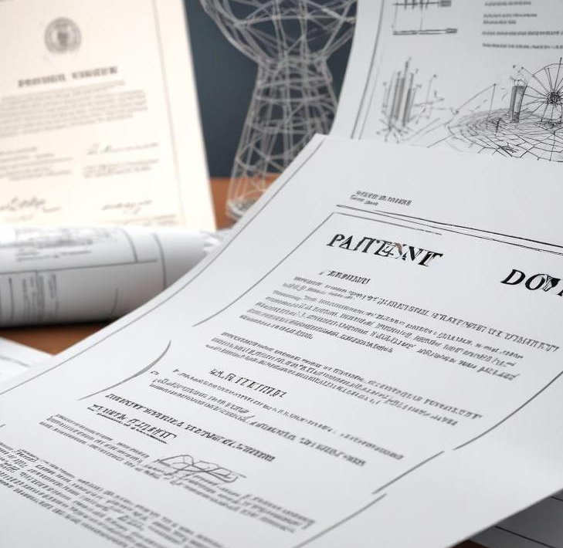
Patents Held
Airwolf 3D has secured several patents related to their unique designs and technologies in the 3D printing industry. Patents cover innovations in printing processes, materials used, and printer mechanics, helping to protect their products and maintain a competitive edge.

Slide 18
Innovation Timeline
Since its inception, Airwolf 3D has introduced various innovative products and improvements in technology. Key milestones include the launch of their first printer in 2013, advancements in materials used for printing, and features that have greatly enhanced user experience and performance over the years.

Slide 19
Competitive Advantage
Airwolf 3D's competitive advantages stem from its commitment to quality, a strong focus on customer service, and continuous innovation. They leverage their expertise to ensure that their products exceed customer expectations, stay ahead of market trends, and adapt to user feedback, all leading to increased customer loyalty.

Slide 20
Digital Presence
05

Slide 21
Website Overview
The Airwolf 3D website serves as a comprehensive platform for customers. It features detailed product listings, user manuals, support resources, and a blog with updates on industry trends. The website is designed to be interactive and informative, enhancing customer engagement and satisfaction.

Slide 22
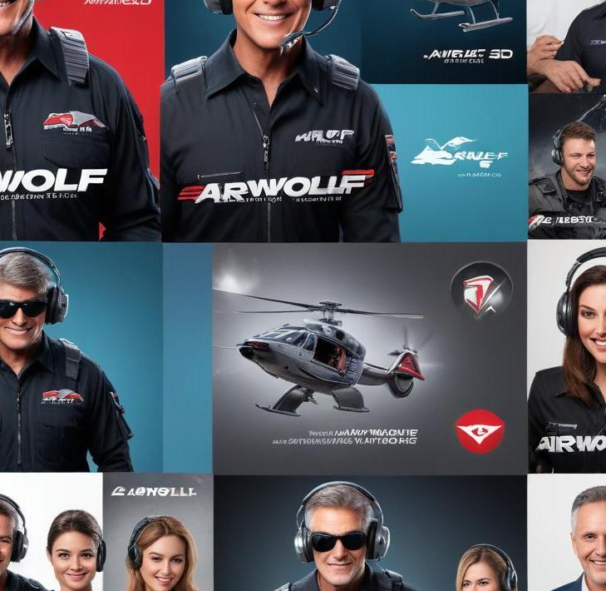
Social Media Engagement
Airwolf 3D actively engages with its customer base through various social media platforms such as Instagram, Facebook, and Twitter. They share updates, tutorials, customer success stories, and encourage user-generated content, building a community around their brand and fostering relationships with users.

Slide 23
Online Reputation
Airwolf 3D has maintained a positive online reputation, bolstered by customer testimonials and reviews highlighting their product quality and service. Their strategic online engagement and active presence on forums and review sites have helped establish trust within the 3D printing community.

Slide 24
Conclusions
Airwolf 3D stands out as a leader in 3D printing technology, with a solid foundation in innovation, a diverse product range, and a strong digital presence. As they continue to grow, their dedication to quality and customer satisfaction will likely ensure their ongoing success in the industry. And you can reach us on https://airwolf3d.com

Slide 25
Thank you!!!
Any questions ?

